Slide 1


Slide 2
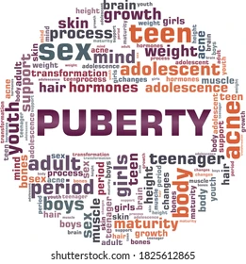
Puberty and secondary sexual development
Ass. Prof. Dr. Sawsan Talib
Department of Obstetrics and Gynecology
College of medicine/ Diyala University
Lec 2/5th stage /2021-2022

Slide 3

Normal puberty
Puberty is the process of reproductive and sexual development and maturation that changes a child into an adult.
During childhood, the HPO axis is suppressed and levels of GnRH, FSH and LH are very low.
From the age of 8–9 years GnRH is secreted in pulsations of increasing amplitude and frequency.
This stimulates secretion of FSH and LH by the pituitary glands, which triggers follicular growth & oestrogen production

Slide 4
The exact mechanism is still unknown, but it is influenced by race, heredity, body weight and exercise.
Leptin plays a role in the onset of puberty.
The physical changes are
.

Slide 5
GH secretion also increases ( pubertal growth spurt).
The mean age of menarche is 12.8 years and it may take over 3 years before establishing a regular pattern.
Initial cycles are usually anovulatory and irregular.
The absence of menstruation is called amenorrhoea and may be primary or secondary .
Pubertal development was described by Tanner (breast and pubic hair development) , (stages 1–5)

Slide 6
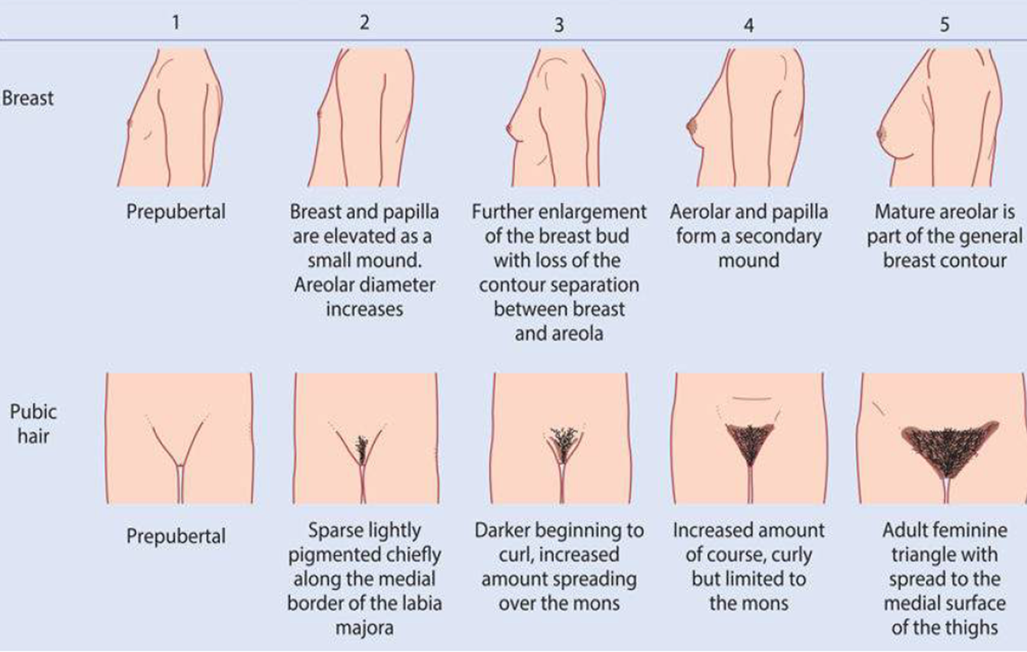
Tanner staging

Slide 8
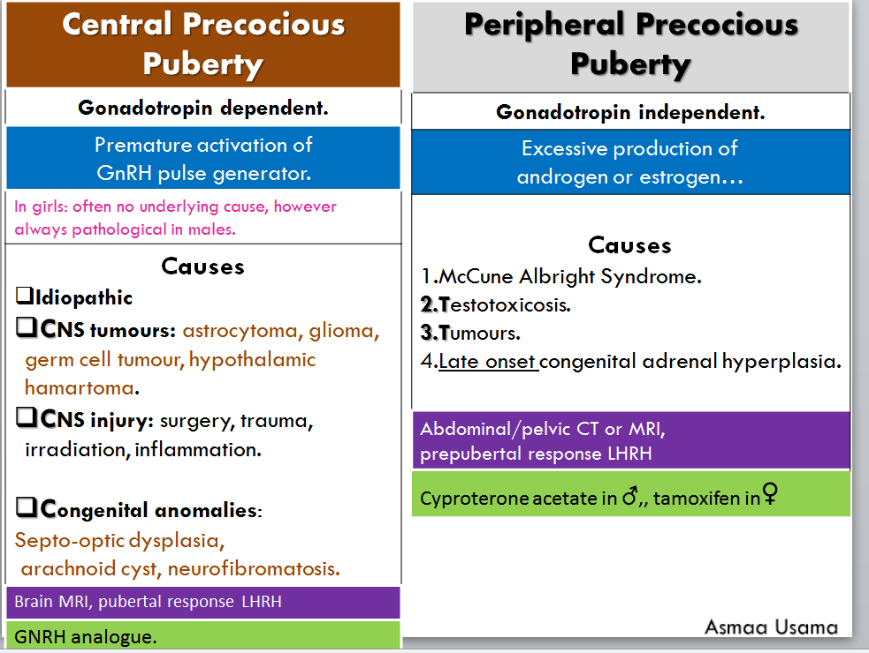
Precocious puberty
This is defined as the onset of puberty before the age of 8 in a girl or 9 in a boy
25% pathological
Always pathological

Slide 9
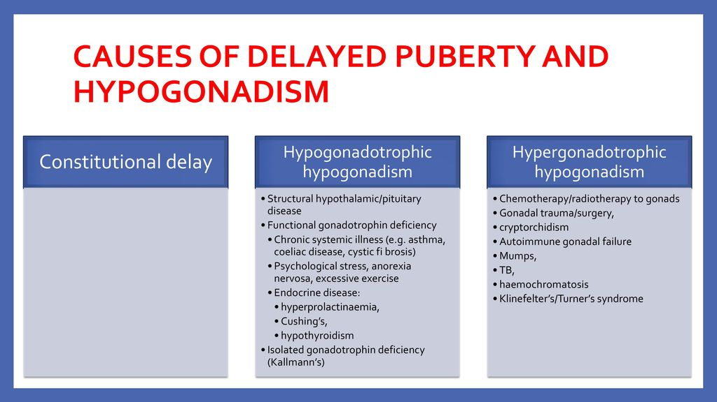
Delayed puberty
When there are no signs of secondary sexual characteristics by the age of 14 years or no menses by age of 16

Slide 10
Hypogonadotrophic hypogonadism
Associated with delayed puberty and primary amenorrhoea.
Hypergonadotrophic hypogonadism
Associated with delayed puberty and primary amenorrhoea.
Can also occur later in life and will cause secondary
amenorrhoea after normal sexual development.

Slide 11
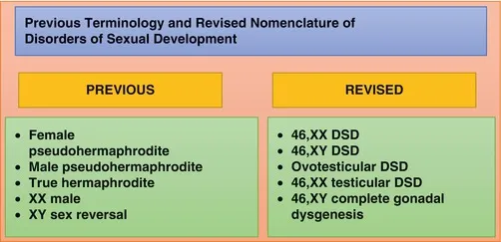
Disorders of sexual development
The sequence of events of puberty does not happen.
May be diagnosed at birth with ambiguous genitalia, but may also be seen at puberty as primary amenorrhoea or increasing virilization.
Older terms, such as ‘hermaphrodite’ and ‘intersex’, are confusing to both the clinician and patients, and in addition can be hurtful.

Slide 12
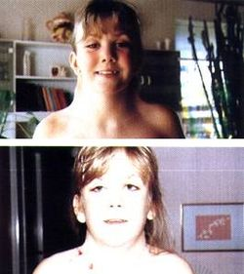
Non-structural causes of DSD
1- Turner syndrome
Results from a complete or partial absence of one X chromosome (45XO).
Is the most common chromosomal anomaly in females, occurring in 1 in 2,500 live female births.
A mosaic karyotype is not uncommon, leading to a variable presentation.

Slide 13
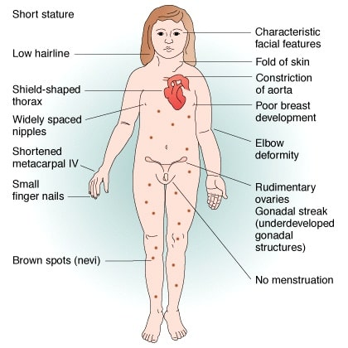
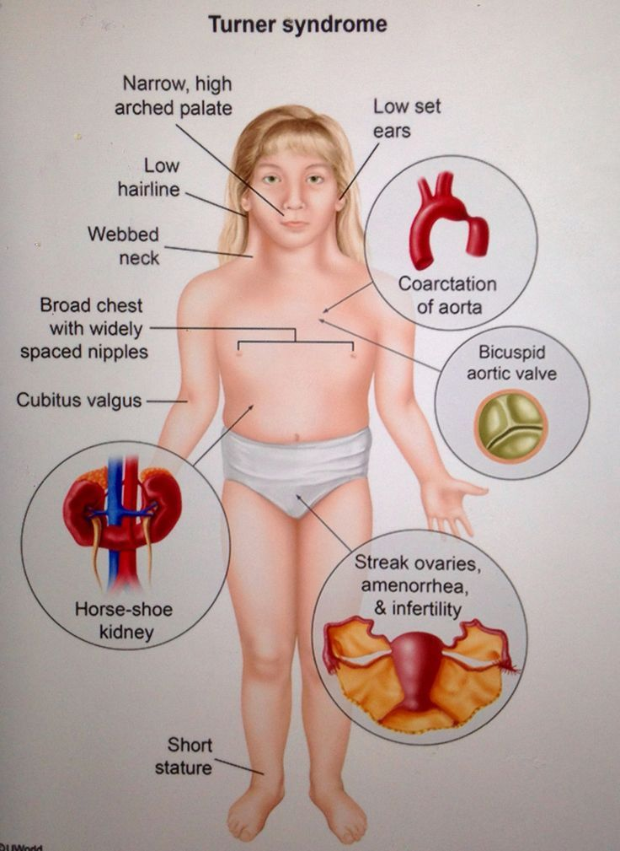
Typical clinical features include
Short stature,
Webbing of the neck
Wide carrying angle.
Associated medical conditions include
Coarctation of the aorta,
Inflammatory bowel disease,
Sensorineural and conduction deafness,
Renal anomalies
Endocrine dysfunction, such as autoimmune thyroid disease.

Slide 14
The gonads are ‘streak gonads’ and do not produce oestrogen or oocytes.
Diagnosis is usually made at birth or in early childhood from the clinical appearance of the baby or due to short stature .
In about 10% of women, the diagnosis is not made until adolescence with delayed puberty.

Slide 15
Treatment
In childhood, treatment is focused on growth.
In adolescence treatment is focused on induction of puberty.
Pregnancy is only possible with ovum donation.
Psychological support is important.
In girls with mosaicism the clinical picture can vary and normal puberty and menstruation can occur, with early cessation of periods

Slide 16
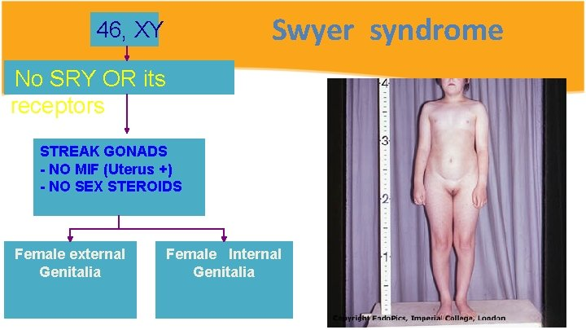
2- 46XY gonadal dysgenesis
The gonads do not develop into a testis, despite the presence of an XY karyotype. In about 15% of cases, this is due to a mutation in the SRY gene on the Y chromosome.
In most cases the cause is unknown.
In complete gonadal dysgenesis (Swyer syndrome), the gonad remains as a streak gonad and does not produce any hormones.
In the absence of anti-Müllerian hormone (AMH), the Müllerian structures do not regress and the uterus, vagina and Fallopian tubes develop normally

Slide 17
The absence of testosterone means the fetus does not virilize.
The baby is phenotypically female.
Although has an XY chromosome. The gonads do not function and presentation is usually at adolescence with delayed puberty.
The dysgenetic gonad has a high malignancy risk and should be removed when the diagnosis is made. This is usually performed laparoscopically.
Puberty must be induced with oestrogen
Pregnancies are possible with a donor oocyte.
Need psychological support.

Slide 18
Mixed gonadal dysgenesis
XX/XY mosaicism is present in up to 20%.
Both functioning ovarian and testicular tissue can be present (ovotesticular DSD).
The anatomical findings depending on gonadal function
If the testis is functional, then the baby will virilize and have ambiguous or normal male genitalia.
The Müllerian structures are usually absent on the side of the functioning testis, but a unicornuate uterus may be present if there is an ovary .

Slide 19
3- 46XY DSD
The most common cause of 46XY DSD, complete androgen insensitivity syndrome (CAIS).
Occurs in individuals where virilization of the external genitalia does not occur, due to a partial or complete inability of the androgen receptor to respond to androgen stimulation.
Testes form normally , secrete AMH, leading to the regression of the Müllerian ducts.
The baby is born with normal female external genitalia, an absent uterus and testes that are found somewhere in their line of descent.
If the testes are in the inguinal canal they can cause a hernia.

Slide 20
Management
psychological with full disclosure of the XY karyotype and the information that the patient will be infertile.
Gonadectomy is recommended because of the risk of testicular CA, this can be deferred until after puberty.
Once the gonads are removed, long-term HRT will be required.
Vaginal dilation is for improving vaginal length.
Surgical vaginal reconstruction for those that have not responded to a dilation.
In partial androgen insensitivity, the androgen receptor can respond to some extent with limited virilization. The child is usually diagnosed at birth with ambiguous genitalia.

Slide 21
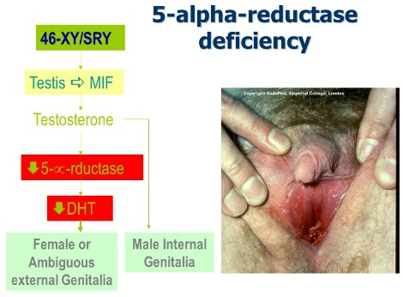
4 -Alpha-reductase deficiency (no uterus)
XY karytype and normal functioning testes that produce both testosterone and AMH.
Unable to convert testosterone to DHT in the peripheral tissues and so cannot virilize normally.
Presentation is usually with ambiguous genitalia at birth.

Slide 22
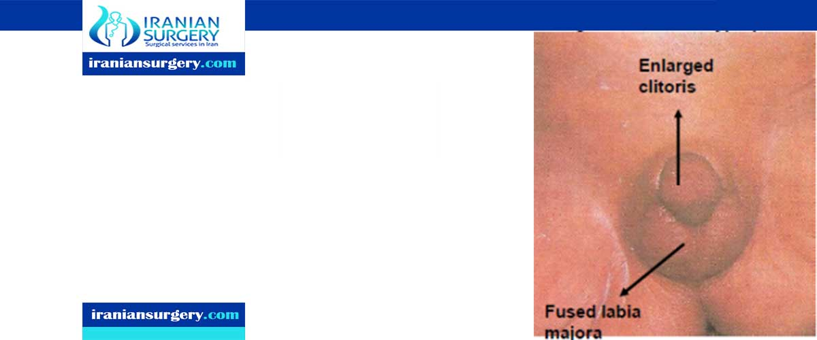
5- 46XX DSD
The most common cause is congenital adrenal hyperplasia (CAH), leads to virilization.
An enzyme deficiency in the corticosteroid pathway in the adrenal gland, 90% 21-hydroxylase deficiency.
The negative-feedback resulting in hyperplasia of the adrenal glands.
This leads to an excess of androgen , virilization of the external genitalia. The clitoris is enlarged and the labia are fused and scrotal in appearance.

Slide 23
2/3 of children will have a ‘salt-losing’ variety, inability to produce aldosterone, is a life threatening , often become dangerously unwell within a few days of birth.
Require life-long steroid replacement, such as hydrocortisone.
Once the infant is stabilized on their steroid regime, surgical treatment of the genitalia is considered, feminizing genital surgery within the first year of life.
A multidisciplinary team (MDT) involving surgeons, endocrinologists and psychologists are required.

Slide 24



